Slide 1
CRAYON – PEOPLE ATTRITION
Szilvia Kepesi

Slide 2
AGENDA
Introduction
Data discovery
Model results
Summary

Slide 3
INTRODUCTION
Attrition is a problem that impacts all businesses, and it leads to significant costs for a business, including the cost of business disruption, hiring new staff and training new staff.
Therefore, businesses, in particular their HR departments have great interest in understanding the drivers of and minimizing staff attrition. The use of classification models to predict if an employee is likely to quit could greatly increase HR’s ability to intervene on time and remedy the situation to prevent attrition.

Slide 4
DATA DISCOVERY
What do we see from the employees?

Slide 5
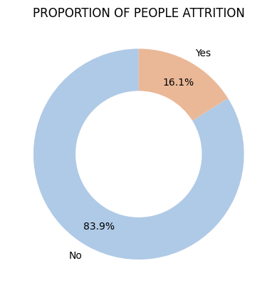
WHAT IS THE PROPORTION OF People attrition?
MAY 2023
PAGE 5

Slide 6
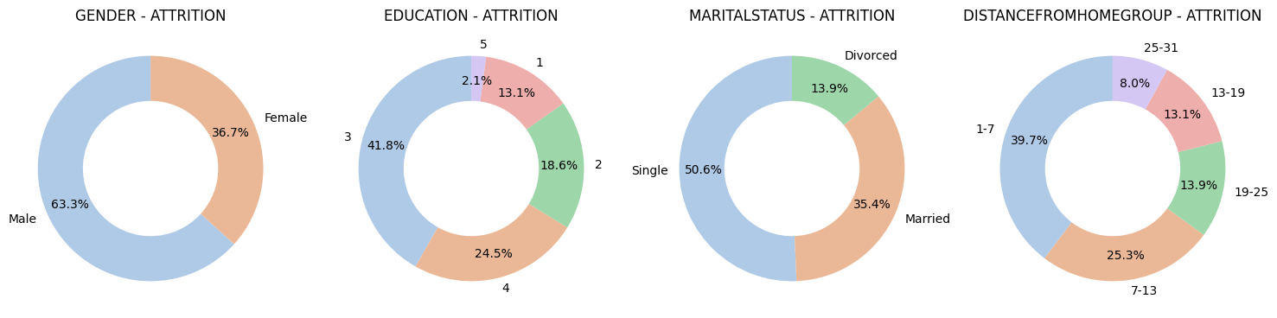
How the proportion changes across the demographies?
MAY 2023
PAGE 6

Slide 7
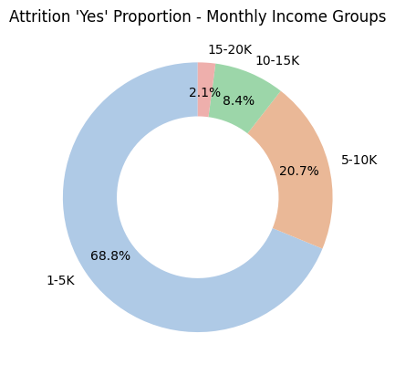
How the proportion changes as per the range of monthly income?
MAY 2023
PAGE 7

Slide 8
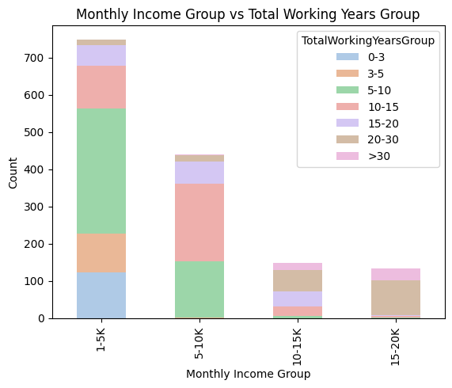
What is the relation between monthly income and total working years?
MAY 2023
PAGE 8

Slide 9
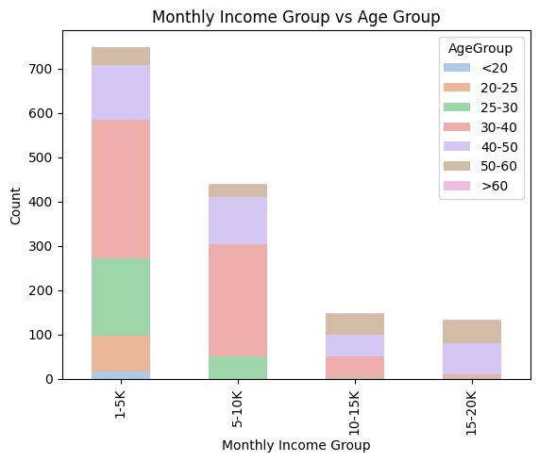
What is the relation between monthly income and age?
MAY 2023
PAGE 9

Slide 10
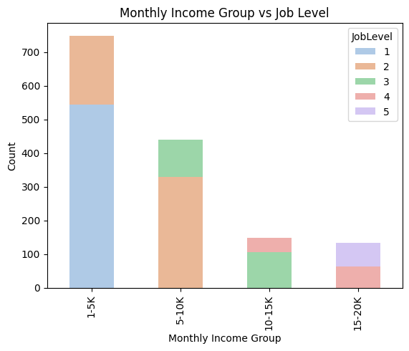
What is the relation between monthly income and job level?
MAY 2023
PAGE 10

Slide 11
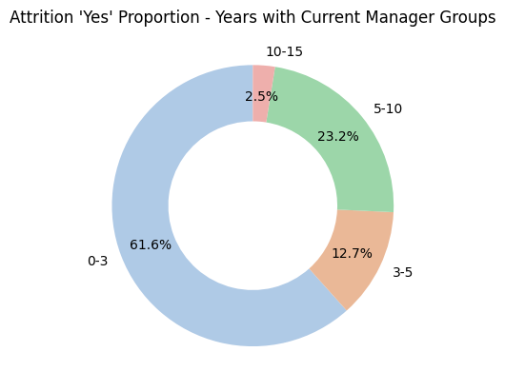
What is the proportion of attrition as per years with current manager?
MAY 2023
PAGE 11

Slide 12
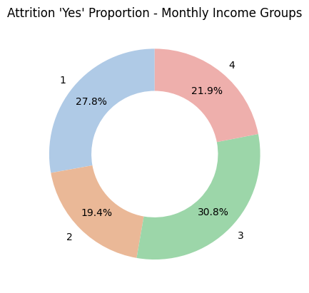
What is the proportion of attrition as per job satisfaction?
MAY 2023
PAGE 12

Slide 13
Result of the optimized MODEL
MODEL | AUC | ACCURACY | F1 SCORE | CROSS VALIDATED AUC | CROSS VALIDATED ACCURACY | TN | FP | FN | TP | LIFT
RANDOMFOREST | 0.999901 | 0.981744 | 0.969112 | 0.993298 | 0.967524 | 226 | 16 | 0 | 251 | 0.969112
SVC | 1.000000 | 0.965517 | 0.969112 | 0.990391 | 0.954847 | 226 | 16 | 0 | 251 | 0.969112
LGBM | 1.000000 | 0.983773 | 0.969112 | 0.990582 | 0.951286 | 226 | 16 | 0 | 251 | 0.969112
MAY 2023
PAGE 13

Slide 14
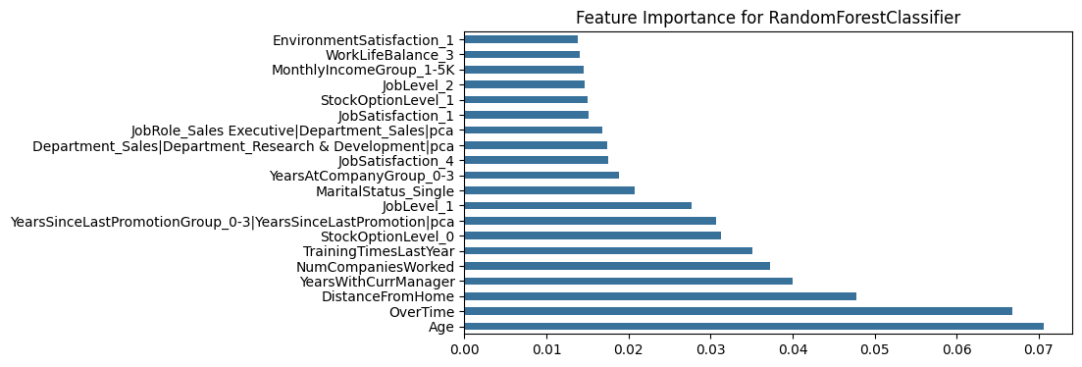
MOST INFLUENCING FEATURES
MAY 2023
PAGE 14

Slide 15
SUMMARY
After cross validation the RandomForest model looks the most successful. It predicts the possibility of employee attrition with 0.993298 AUC. Accuracy and FP are also promising.
Pending tasks>>
Validation of overfitting
Double check if no dummy variable trap occurred
Save best model .pkl
Export csv with prediction indicating employees with possible attrition
MAY 2023
PAGE 15

Slide 16

THANK YOU
SZILVIA KEPESI
malejin@hotmail.com
https://www.linkedin.com/in/szilviakepesi/

